Slide 1

KisaanSaathi
PROBLEM STATEMENT : Agricultural Bot which help farmers to find more
efficient ways to protect their crops from weeds
TEAM MEMBERS : Sharyu Dongre
Rashmikiran Pandit
Payal
Shubhagyta Swaraj Jayswal

Slide 2




Some Statistics
Food production must increase by 70 % in order to feed a world population that is expected to reach 9.6 billion by 2050.
Weeds may reduce about 40 to 50 percent grain yield in wheat crops.
This challenge is even greater when we take into account the agricultural failure caused due to weeds, pests and pathogens.
Weed management becomes the most crucial part given that crop yield losses caused by weeds are 50% higher than any other threat.

Slide 3
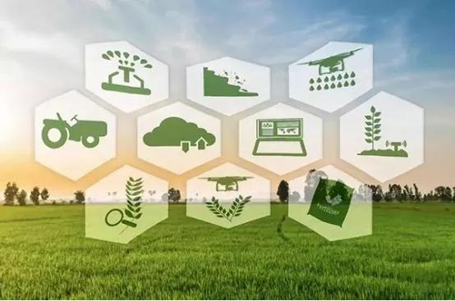

OUR OBJECTIVE
To Empower the Indian farmers with reliable, authentic and correct guidance in easy and feasible way
To build an intelligent chatbot that
specifically assists farmers with weed management

Slide 4

Implementation
Language used: Python3
Python libraries used:
For preprocessing: NLTK and sklearn
Text-to-speech: pyttsx3
For translation: googletrans
GUI made using: tkinter

Slide 5
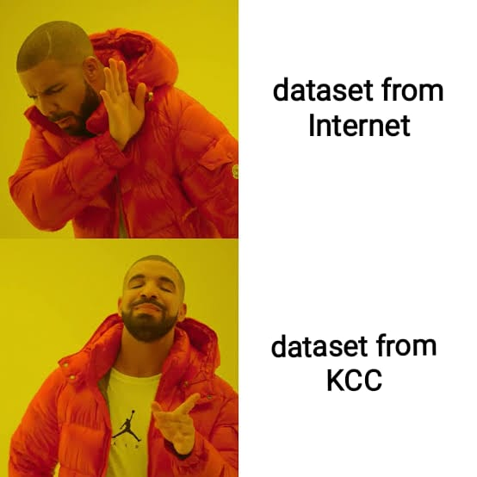
Dataset Collected from:
Kisan Call Center
https://data.gov.in/keywords/kcc

Slide 6
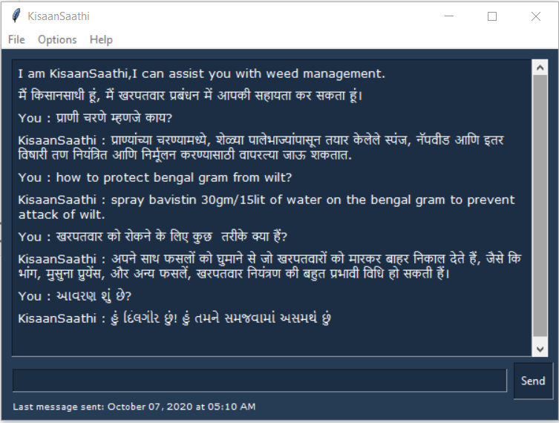
Kisaan Saathi
Demonstration of the chat bot

Slide 7
Working Process
1.Download some resources: ‘punkt’ and ‘wordnet’
2.Tokenization
3.Lemmatization
4.Removing Punctuations
5.TfidVectorizer
6.cosine_similarity
7.Flatten the vector
8.return output response

Slide 8



Further Improvement
Features for Crop Production and Management
Android Application
Web Portal

Slide 9
Motive is to further improving the solutions to weed management by adding features like weather and soil type.
The portal will provide a platform to farmers for interaction with the KisaanSaathi (The Chatbot) as well as the site will function as e-commerce site like amazon, flipkart,etc. From where farmers can place order for required necessities such as fertilizers, pesticides, electronic equipments,etc
The app will provide same features as of website in form of an android application.
Features for Crop Production and Management
Web Portal
Android Application

Slide 10

Thank you
By team Phoemora!

